Slide 1
Parking in Copenhagen

Slide 2
Idea
Explain why people drive by car through parking data.
Provide insights into Copenhagen‘s parking situation and future parking management.
Comprehensive Knowledge about Public Parking in Copenhagen
- Record of Road Occupancy -> Parking Difficulty
- Transaction from Parking Machine -> Temporal and Spatial Character
Analysis and Prediction
- Distribution of Public Facilities -> Parking Hotspots Prediction & High Parking Amount Explanation

Slide 3
Datasets
Parking Counts^{[1]}
24373 Data Points (geo-data)
2007 Roads (Number of legal parking spaces, Actual number of parking cars)
2012 – 2020 Count once in March and September
Historical transaction data of parking payment machines^{[2]}
Year 2015
7192739 Data Points (geo-data)
Starting and ending time of parking, transaction amount, machine code (location)
[1] https://www.opendata.dk/city-of-copenhagen/parkeringstaellinger
[2] https://www.opendata.dk/city-of-copenhagen/parkomat-transaktioner

Slide 4
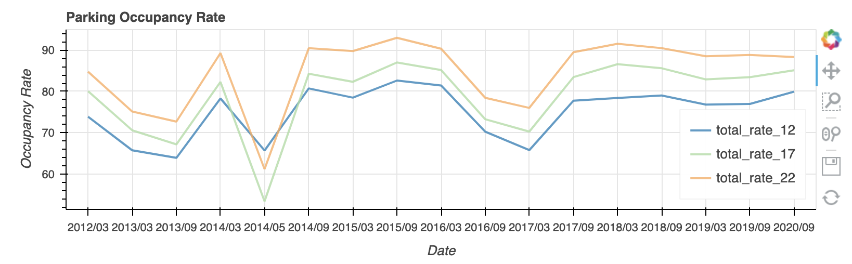
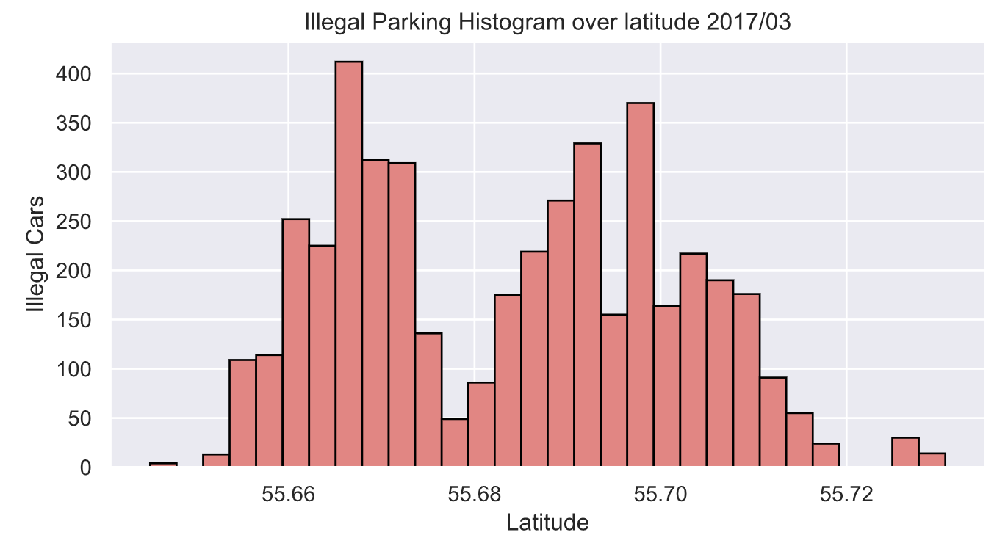
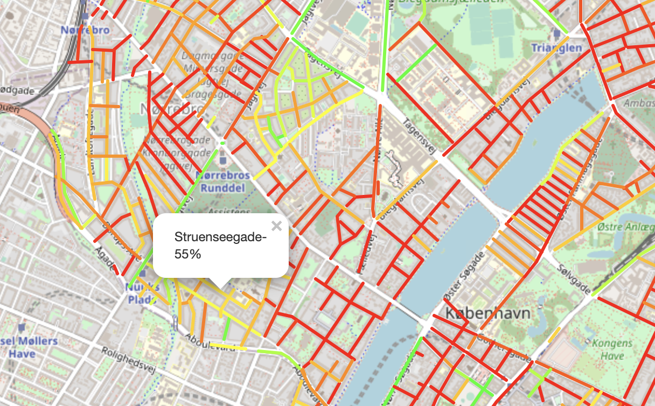
Parking Problem
The average occupancy rate of parking spaces on urban roads is high.
100% occupancy rate of parking spaces on multiple roads.
Illegal parking is serious in some key areas.

Slide 5
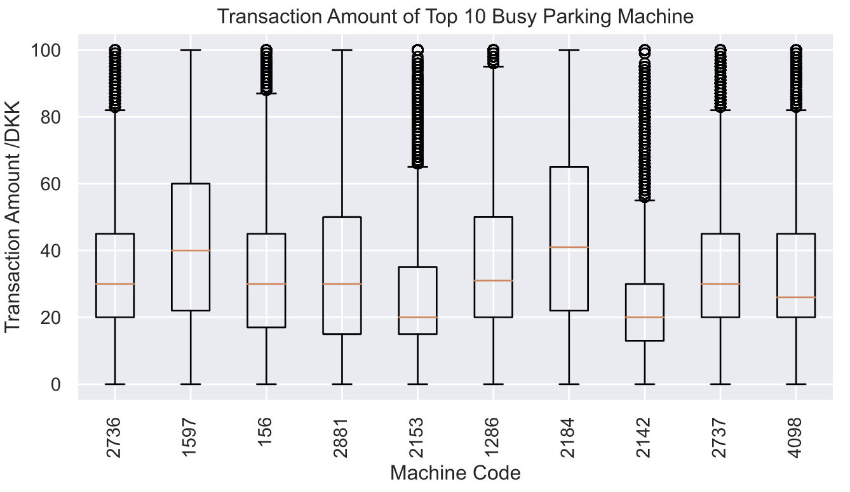
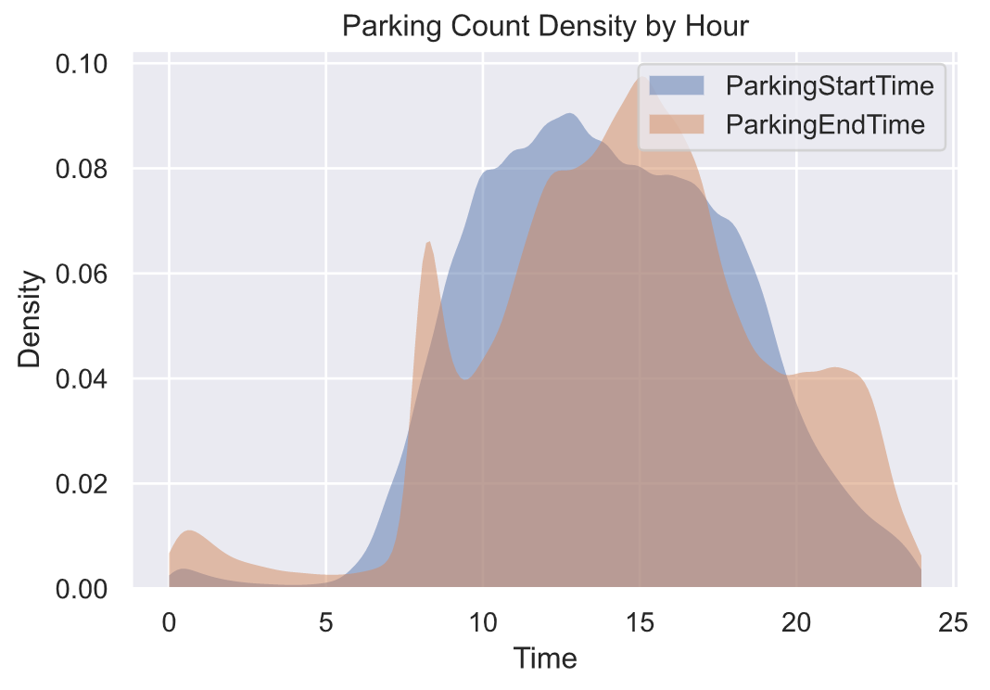
Fundamental Distribution

